Slide 1
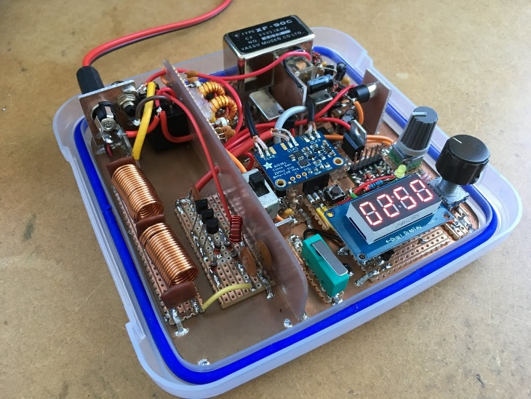

1.12 Software defined radio Initial Design Review
Sponsor: Texas State University
Faculty Advisor: Dr. Stapleton

Slide 2
Project Overview
Software Defined Radio High Frequency (HF) Transceiver
Non-Portable Half Duplex Radio Communications on the HF Band
Notes:
State the problem and the project in clear terms. Use a graphic if at all possible.

Slide 3
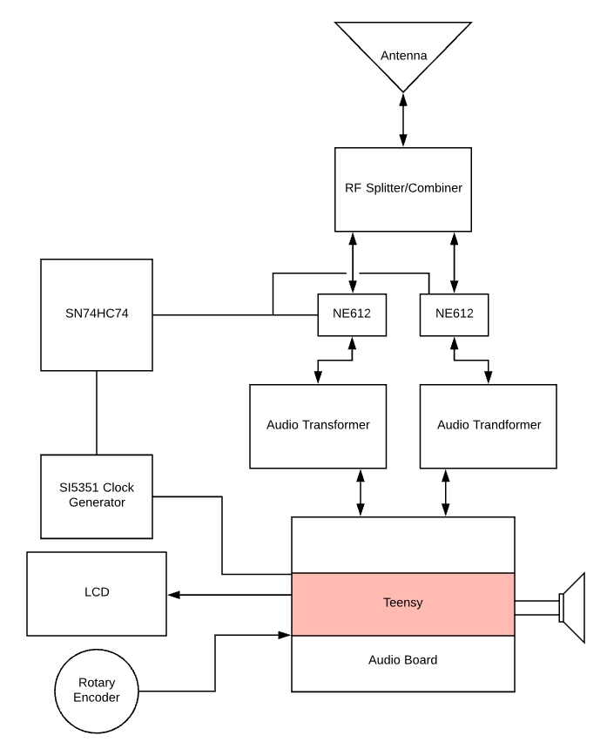
block diagram
NE612 : RF Mixers
SN74HC74 : D Flip Flop Network, Clock Divider and Quadrature Generator
SI5351: Voltage Controlled Oscillator, Sets the Carrier Wave Frequency
Audio Transformer: Audio Signal Isolator
Notes:
Put your project into the larger context.

Slide 4
Project Goals
Goals of Project
Stretch Goals of Project
To make a PCB for the radio
To make it operable for 4 hours on 12V battery power
To make a build kit for the radio
3D printed Case for safety
Have an operable 3.5mm headphone Jack
To create a Half-Duplex Software Defined Radio
To make an educational tool
Notes:
If no stretch goals then delete the text box on the right, and expand the one on the left. DO NOT ELABORATE ON THE GOALS, JUST STATE THEM QUICKLY AND MOVE ON!!!

Slide 5
Roles & Responsibilities
NAME | ROLE
James Bell, Project Manager | Coding for microcontroller
Samuel Hussey
Zachary Schneiderman
Notes:
BRIEF DESCRIPTIONS!!!!! Go over this VERY quickly!

Slide 6
Project-Specific Milestones
MILESTONE | Completion Date | Person(s)
Simulation of analog components | 10/22/18 | Samuel Hussey
Signal Flow chart | 10/22/18 | James Bell
Parts List and Specifications | 10/22/18 | Zachary Schneiderman
Order Parts | 10/25/18 | James Bell
Analog component testing | 11/19/18 | Zachary Schneiderman
Radio receive testing | 11/25/18 | James Bell
Radio transmit testing | 12/5/18 | Samuel Hussey
Notes:
List the major milestones. They are milestones SPECIFIC to YOUR project and NOT deliverables for the class!!!

Slide 7

Project Deliverables
Analog component simulations
Analog component testing
Digital signal processing testing
Radio receiving test and verification
Radio transmission test and verification
Notes:
List the MAJOR deliverables only. These are the deliverables for your PROJECT and NOT for the class! E.g., don’t list “Functional Spec” etc.

Slide 8
Functional Specification Review

Slide 9
2.2 Administration Functions
No Administrative Functions
Notes:
If this section is not relevant to your project then delete this slide. If relevant, talk to this slide for no more than 1 minute!

Slide 10
2.3 Error Handling
We will bound the tunable frequencies by looping the frequency selector over the 3.500MHz – 4.000MHz range and the 14.000MHz – 15.350MHz range.
Pre-set options for license level will be made available to limit the transmission range.
Notes:
Talk to this slide for no more than 1 minute! Remember: ALL designs must handle errors! You may have to think about what they might be!

Slide 11
2.4 Safety & Security
A case will be used to limit accidental contact with components
An LED power indicator will be visible to warn the user the device is on.
Notes:
If this section is not relevant to your project then delete this slide. If relevant, talk to this slide for no more than 1 minute!

Slide 12
You may need to have a block diagram – of various levels – available throughout the presentation to illustrate elements of the design!

Slide 13
2.61 – User Interfaces
Control components (Rotary switches, Rotary encoder, potentiometer, and multi pole switches) will be accessible to modify operation
An LED screen will be visible to allow the user to see frequency selection or other digital choices.
Notes:
These are interfaces between the USER and your SYSTEM.

Slide 14
2.62 – Software Interfaces
The Audio board and Teesny Communicate with I2c
Arduino IDE (1.8.7) with Teesny loader application (1.44) to create, compile, and load code
Stretch goal: Raspbian operating system.
Notes:
These are interfaces between one piece (or language) of software and another due to your design. If this section is not relevant to your project then delete this slide.

Slide 15
2.63 – Hardware Interfaces
(look at schematic/block diagram?)
Notes:
These are interfaces between two pieces of hardware, e.g., you connected a sensor to a pi. If this section is not relevant to your project then delete this slide.

Slide 16
2.64 – Mechanical Interfaces
Mechanical only systems, not electro-mechanical like the switches and relays
Notes:
These are interfaces between two mechanical systems like a motor and a generator. If this section is not relevant to your project then delete this slide. FEW projects have mechanical interfaces.

Slide 17
2.7 Boundary Conditions & Constraints
Notes:
List the boundary conditions and make sure your Sponsor agrees that they are indeed boundary conditions. Talk to this slide for no more than 1 minute!

Slide 18
2.8 Performance
Notes:
This is where you need to spend the majority of your time. You’ll need several slides to cover 2.13.

Slide 19
2.9 Software Platforms
Arduino environment 1.8.7, with the Teensy loader application 1.44 addon on windows 10,
Stretch goal: Raspbian
Notes:
What platforms does your system run on? If this section is not relevant to your project then delete this slide. If relevant, talk to this slide for no more than 1 minute!

Slide 20
2.10 Service, Support & Maintenance
A repository of code by version of schematic will be available on a repository.
Components will be easy to access, and clean.
Notes:
What platforms does your system run on? If this section is not relevant to your project then delete this slide. If relevant, talk to this slide for no more than 1 minute!

Slide 21
2.11 Expandability or Customization
Not in scope of project? Functional spec v1.2
Notes:
What platforms does your system run on? If this section is not relevant to your project then delete this slide. If relevant, talk to this slide for no more than 1 minute!

Slide 22
Challenges & Concerns
Our simulations are not matching our actual devices
The amplifier simulation is not matching the actual build
Notes:
Word this carefully – OK to ask questions and seek resolution during the IDR. CLASS DELIVERABLES and/or team meetings ARE *NOT* CHALLENGES!!!

Slide 23
Project Progress
Simulations of analog components completed for:
Analysis of electronic components completed for:
Amplifier,
Research completed for:
Single sideband signal
Signal flow through device
Notes:
Go through this at a good pace. You could spend 30 minutes on this alone – don’t. Just give an overview.

Slide 24
Future Tasks
Tasks Planned for the Completion of the project:
Order parts
Assemble analog components
Test analog components against simulations
Test digital signal processing
Combine parts for Software Defined Radio
Received signal test for Software Defined Radio
Notes:
High level tasks! DO NOT enter items like, “order 100 ohm resistors.”

